Slide 1

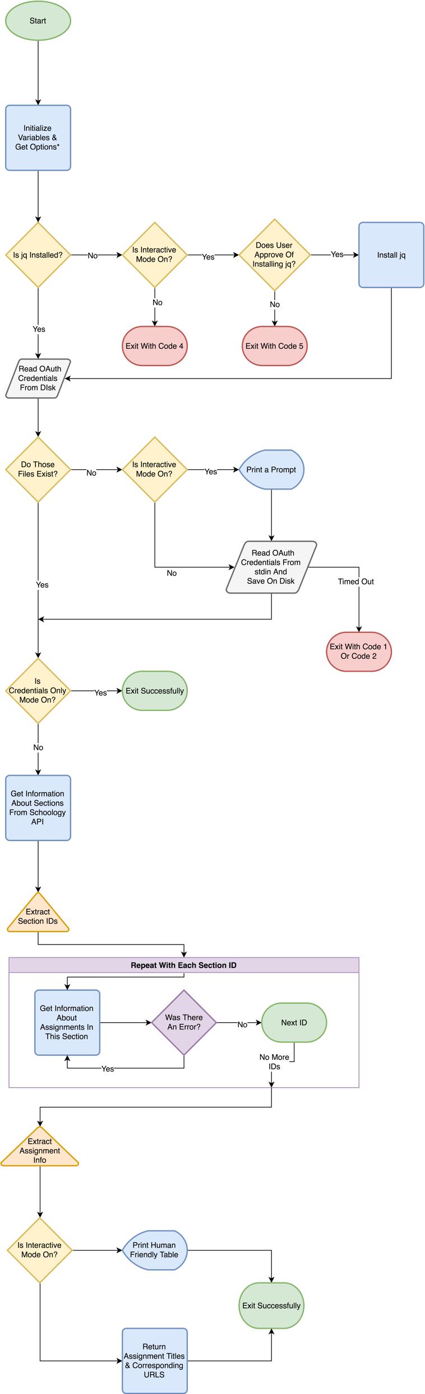


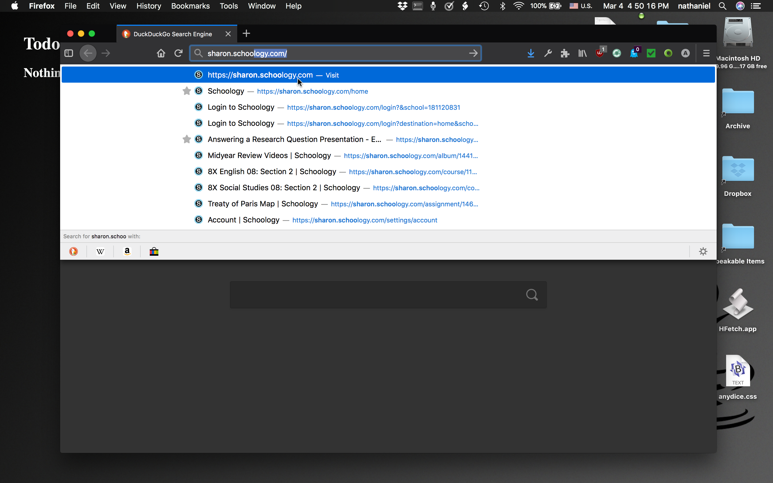
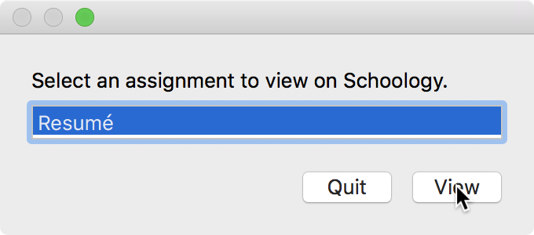
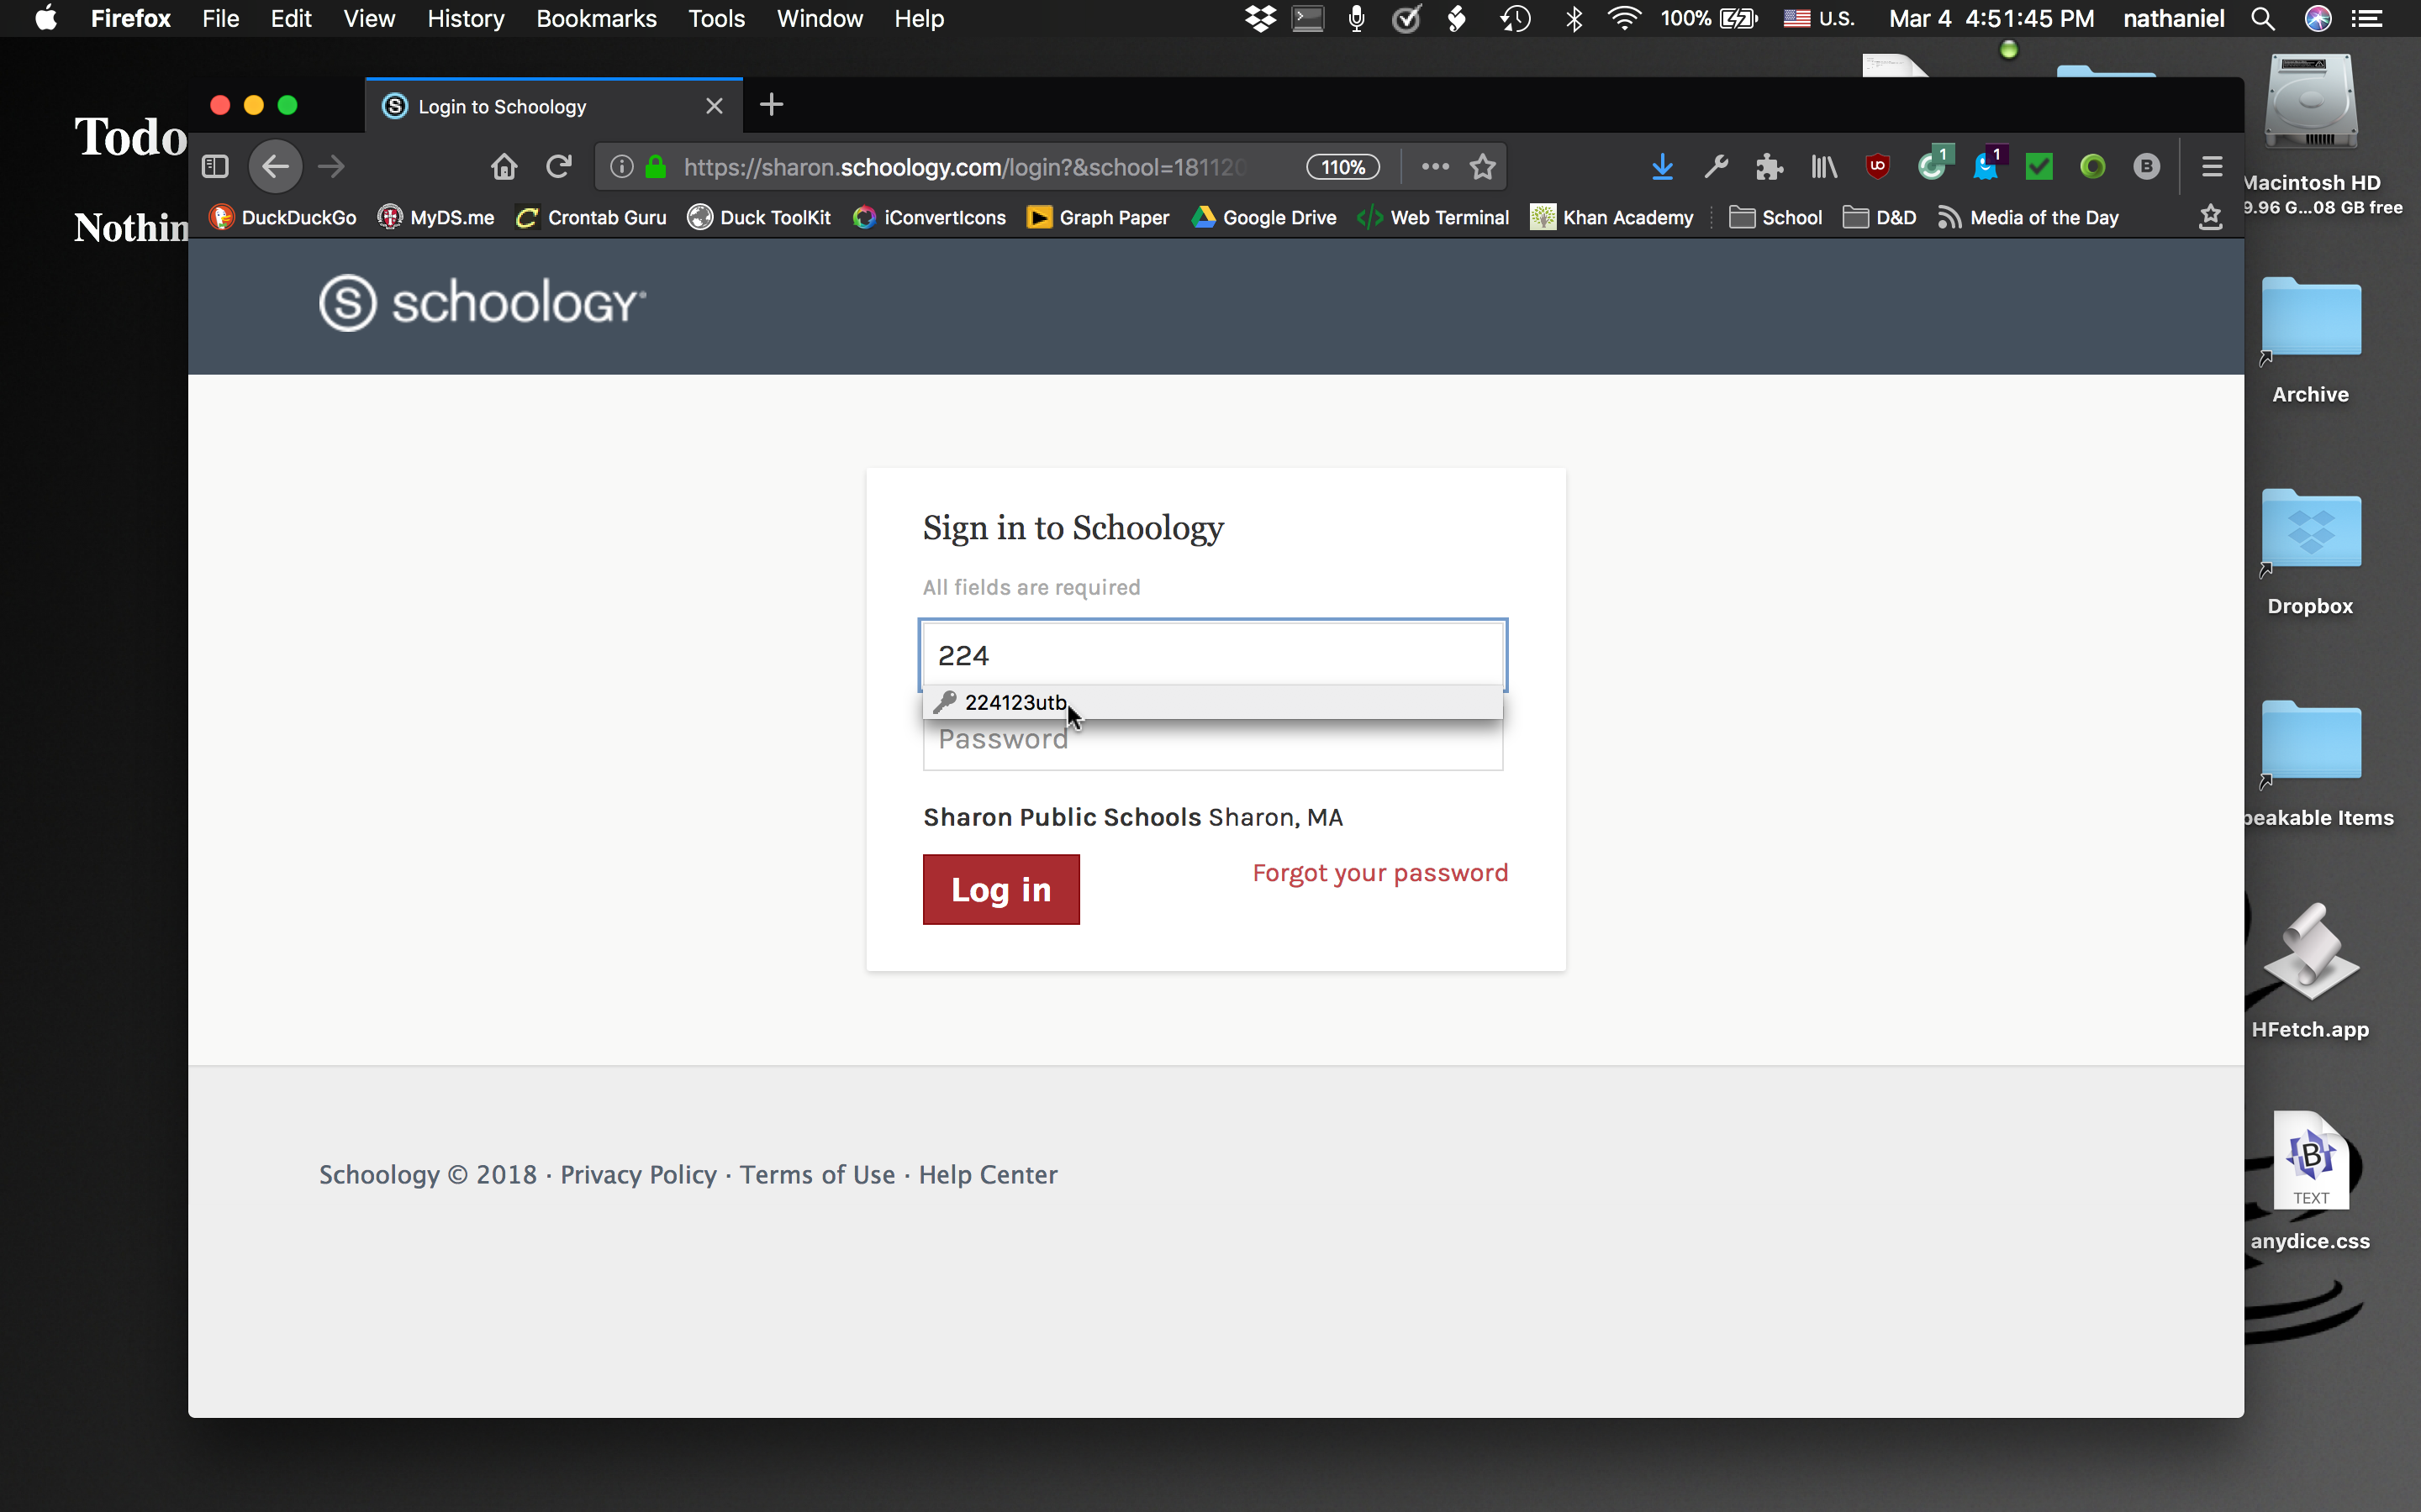
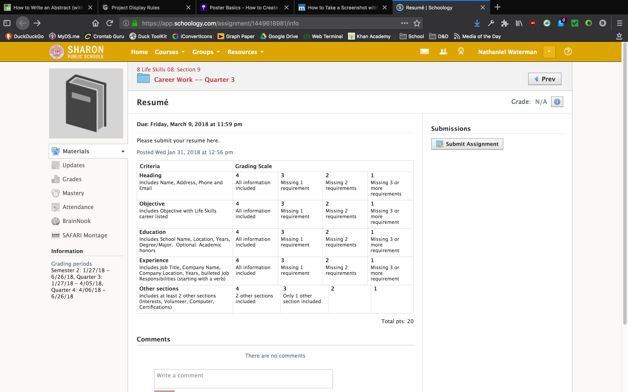
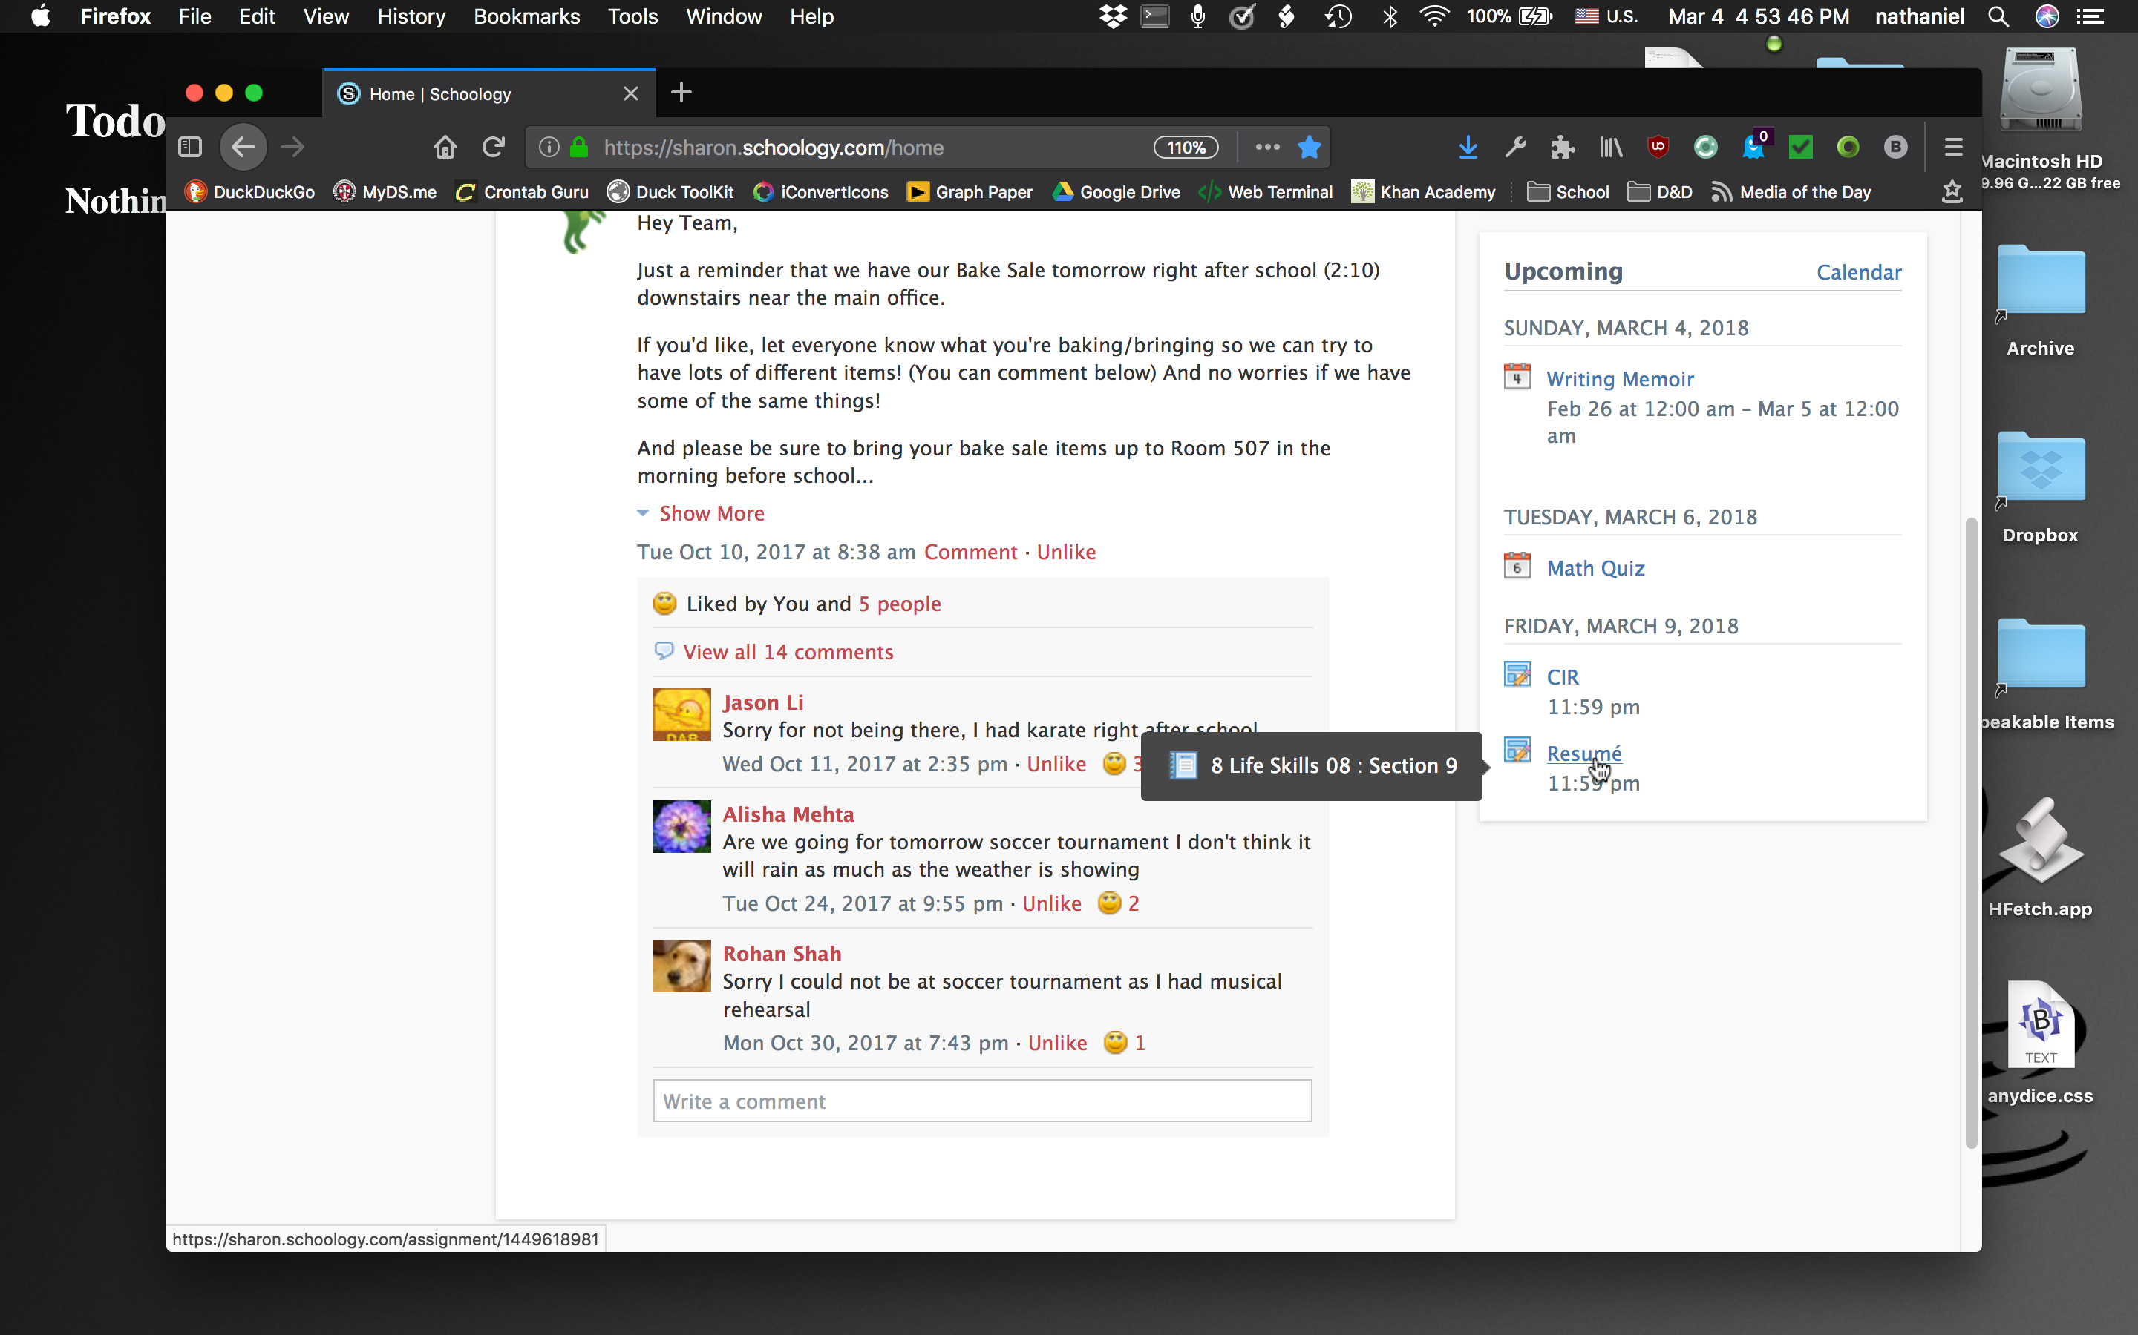
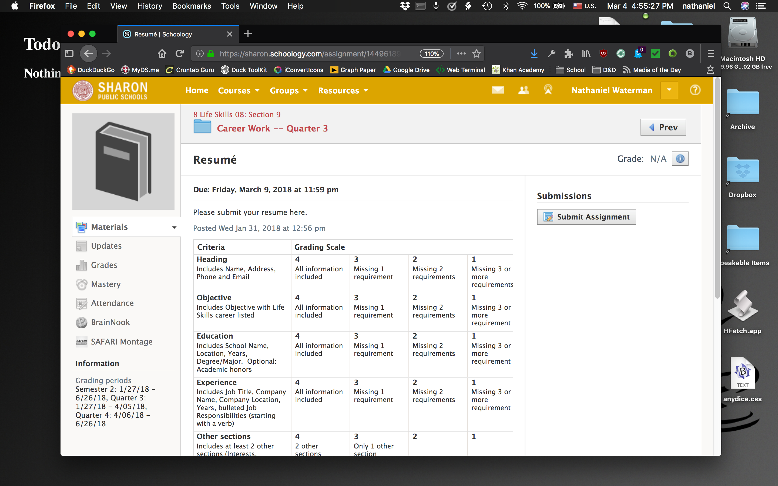
HFetch: A User-Friendly API Client for Schoology
Using the Schoology API to Simplify Checking for Homework
Nathaniel Waterman
Introduction
Figure 1a:
Browser
4 Steps
Figure 1b:
HFetch
2 Steps
Figure 2:
Shell Script
Flowchart
Conclusions
Schoology is a website on which teachers can post assignments and resources for their students to access anywhere.^{[3]}
This website is popular and powerful, but it takes time to check for homework posted there. This was the motivation for designing HFetch, which uses a RESTful API to fetch, display, and provide details about assignments from Schoology.
HFetch makes homework easier to remember, and allows for automation, such as with the cron utility^{[5]} or Automator on MacOS.
Background
References
Schoology has a RESTful API in order to allow for the creation of tools to enrich the Schoology experience.^{[4]} REST is a standard for web services which allows the access and manipulation of web resources by way of a set of stateless, (each message is independent of the others) predefined operations.^{[2]}
[1] c47s/getassgns. url: https://github.com/c47s/getassgns/. [2] Relationship to the World Wide Web and REST Architectures. url: https://www.w3.org/TR/2004/NOTE-ws-arch-20040211/#relwwwrest.
[3] Schoology. url: https://www.schoology.com/.
[4] Schoology API Documentation. url: https://developers.schoology.com/api-documentation/design-architecture.
[5] What are cron and crontab, and how do I use them? url: https://kb. iu.edu/d/afiz.
Objective
To create a user-friendly utility for fetching homework from Schoology.
Figure 2
HFetch is comprised of an AppleScript app and a shell script.^{[1]} The script is self-contained, and its primary purpose is to interact with the API. It can also be run from the command line, and has an interactive mode for this purpose. The app provides a GUI.
Figure 1
Further Development
Checking homework and viewing the details of an assignment is much faster with HFetch (Fig. 1b) than with a web browser (Fig. 1a) – using HFetch requires half as many steps, does not require logging in, and can be automated such that it takes only 1 step.
In future, a user interface should be created for Linux and the program should be ported to Windows.

